Slide 1
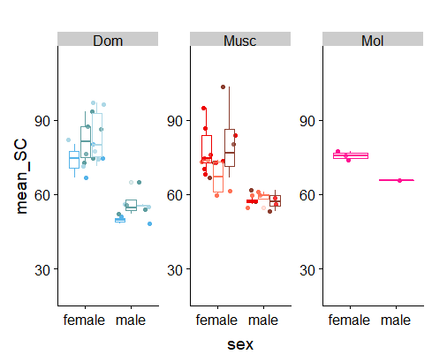
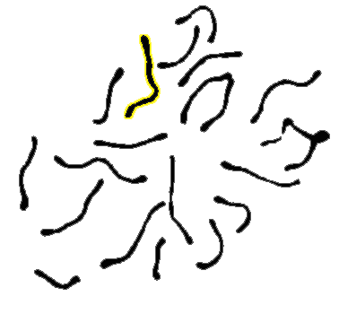
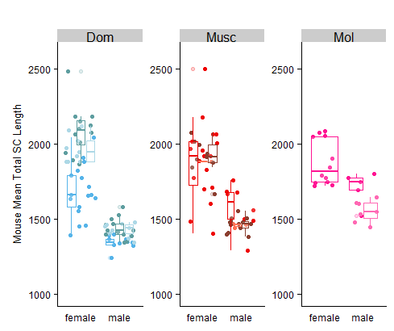
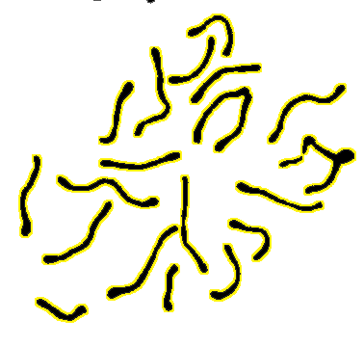
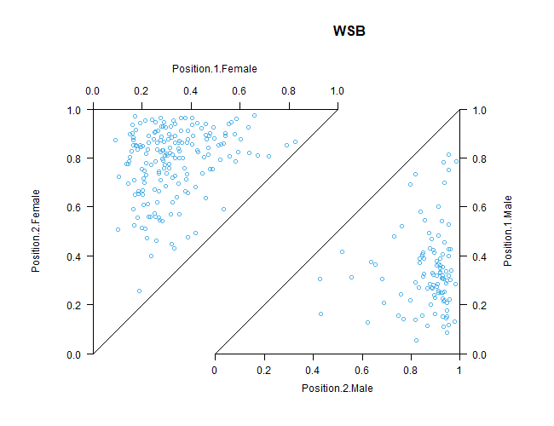
Q1 Figure
A.
B.
Sex differences in Inter-focal Distances
♀
Area of shortest IFDs
1st Foci Position
2nd Foci Position
1. Female more uniform placement.
2. Male strong terminal placement of second foci.
3. Enrichment of long IFD, few short IFD.
Area of longest IFDs
1st Foci Position
♂
2nd Foci Position
Notes:
SC Length - boxplots for all subspecies, total SC and short
IFD -
Example both sexes right triangles
CO Positions ♀♂

Slide 2
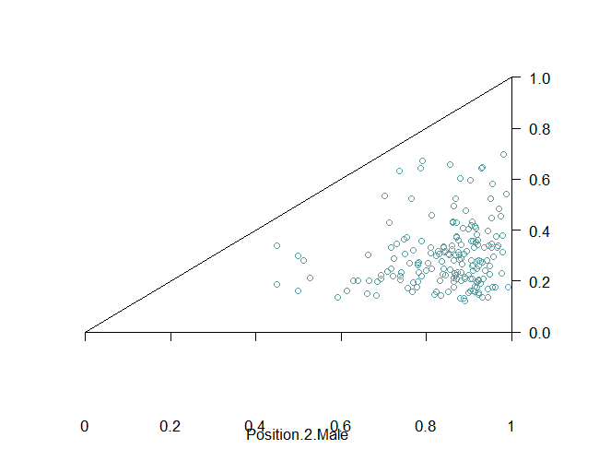
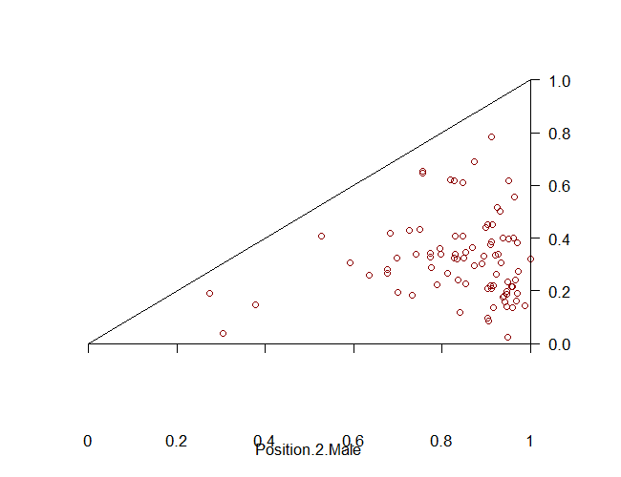
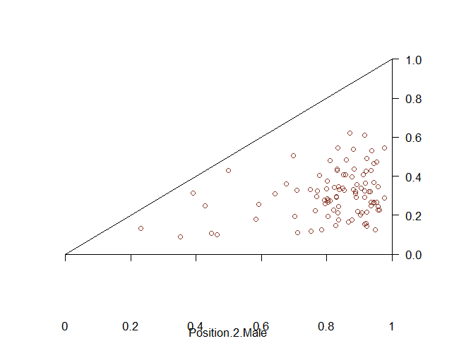
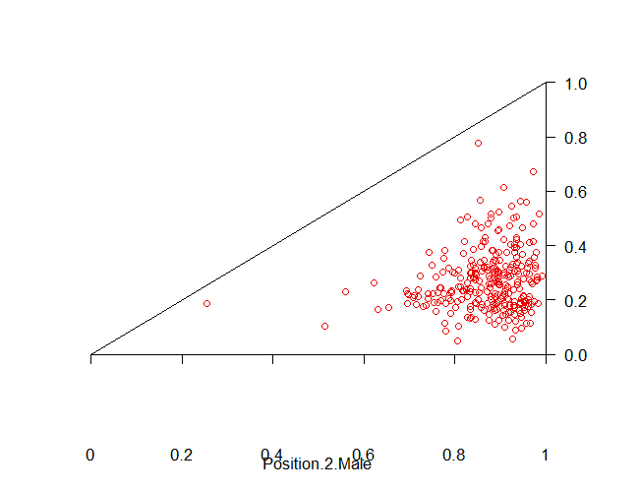
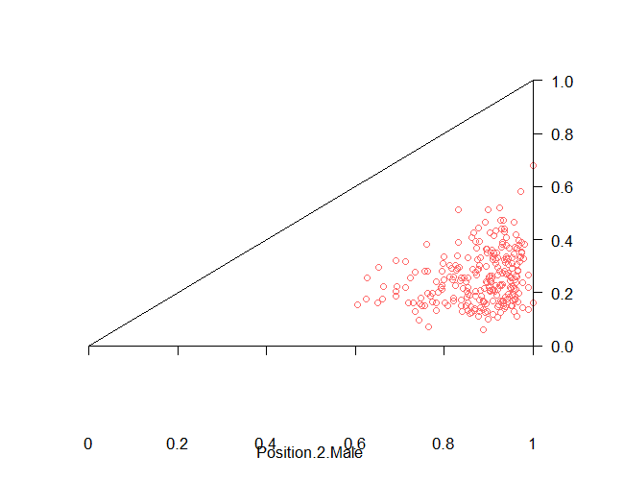
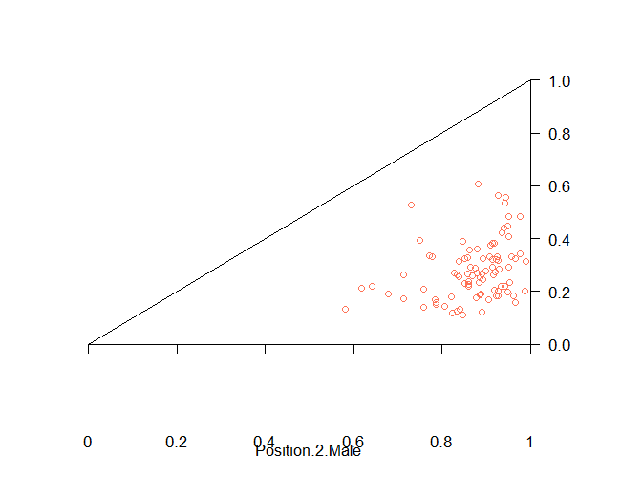
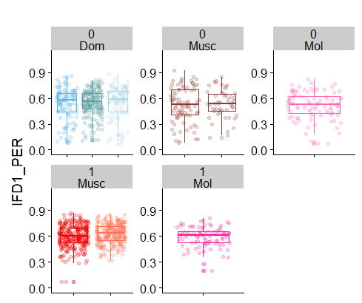
Q2. (strain differences)
A.
B.
Can’t figure how to make triangle by subspecies
Notes:
Example IFDs (merge the subspecies * rec group
--boxplots for IFD (do I need both of these?)
-- 1CO position

Slide 3
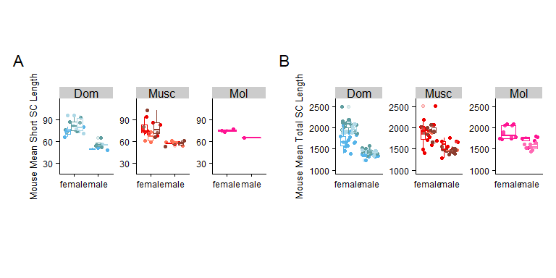
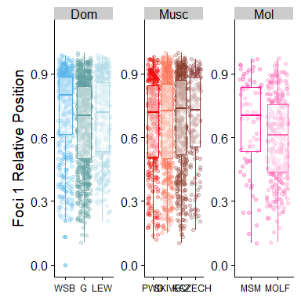
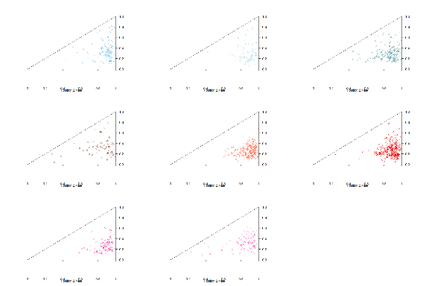
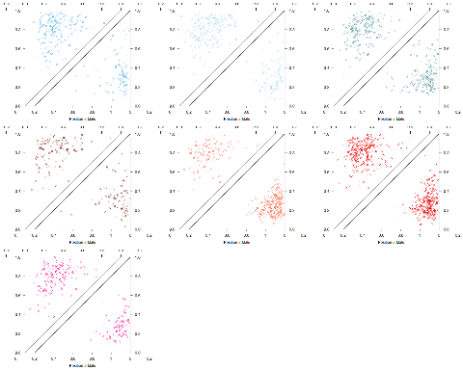
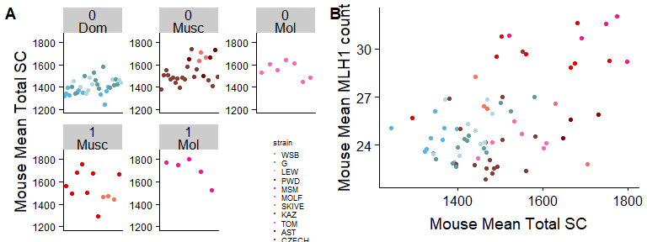

Slide 4
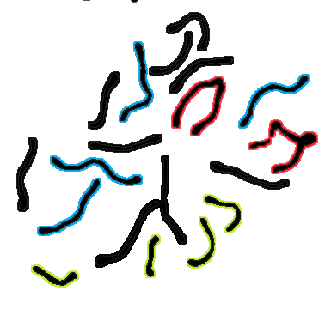
Methods Fig
Total SC
1CO Position
Single Bivalent
And reduced bivalent dataset
2CO IFD
Curation
-remove XY, overlapping chrms
Short and long dataset

Slide 5
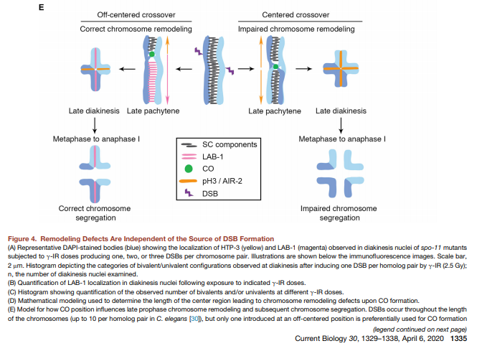
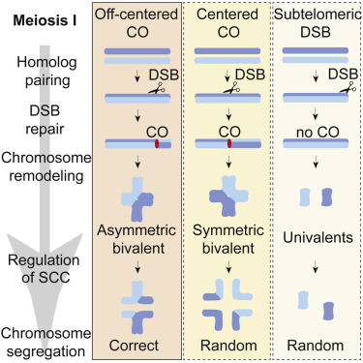
MI spindle selection based
Bivalent str
alterdorer
Lee
Notes:
Why is symmetrical crossover placement bad?
-resrouce limited?
-sub-optimal physiological signal

Slide 6
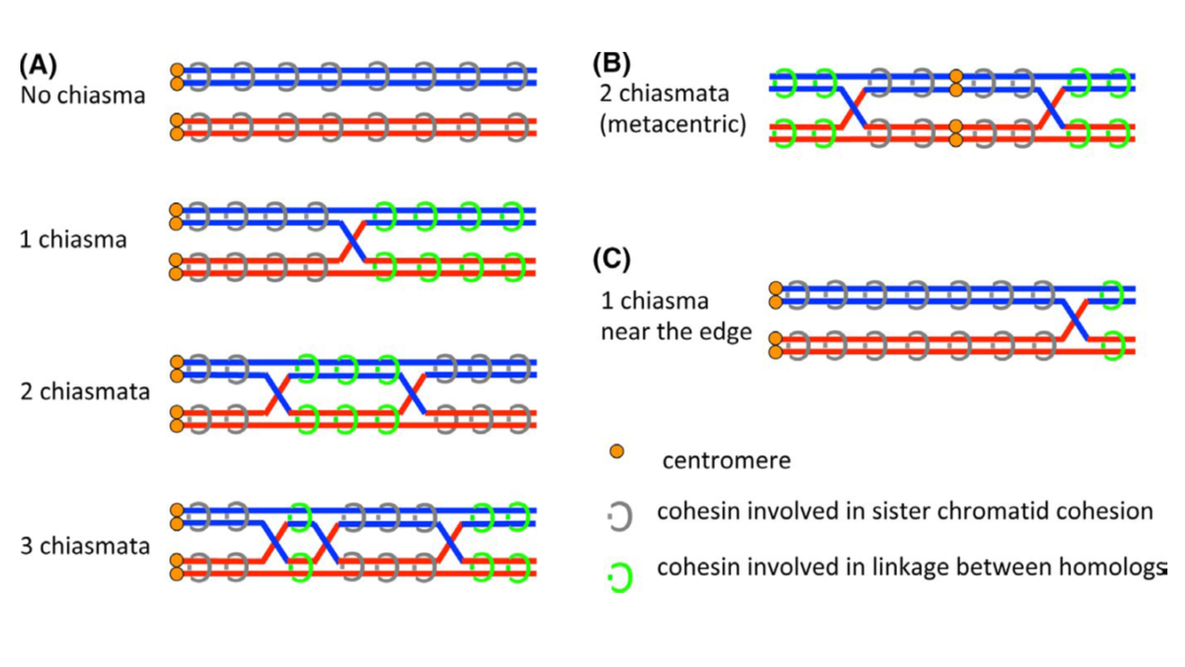

Slide 7
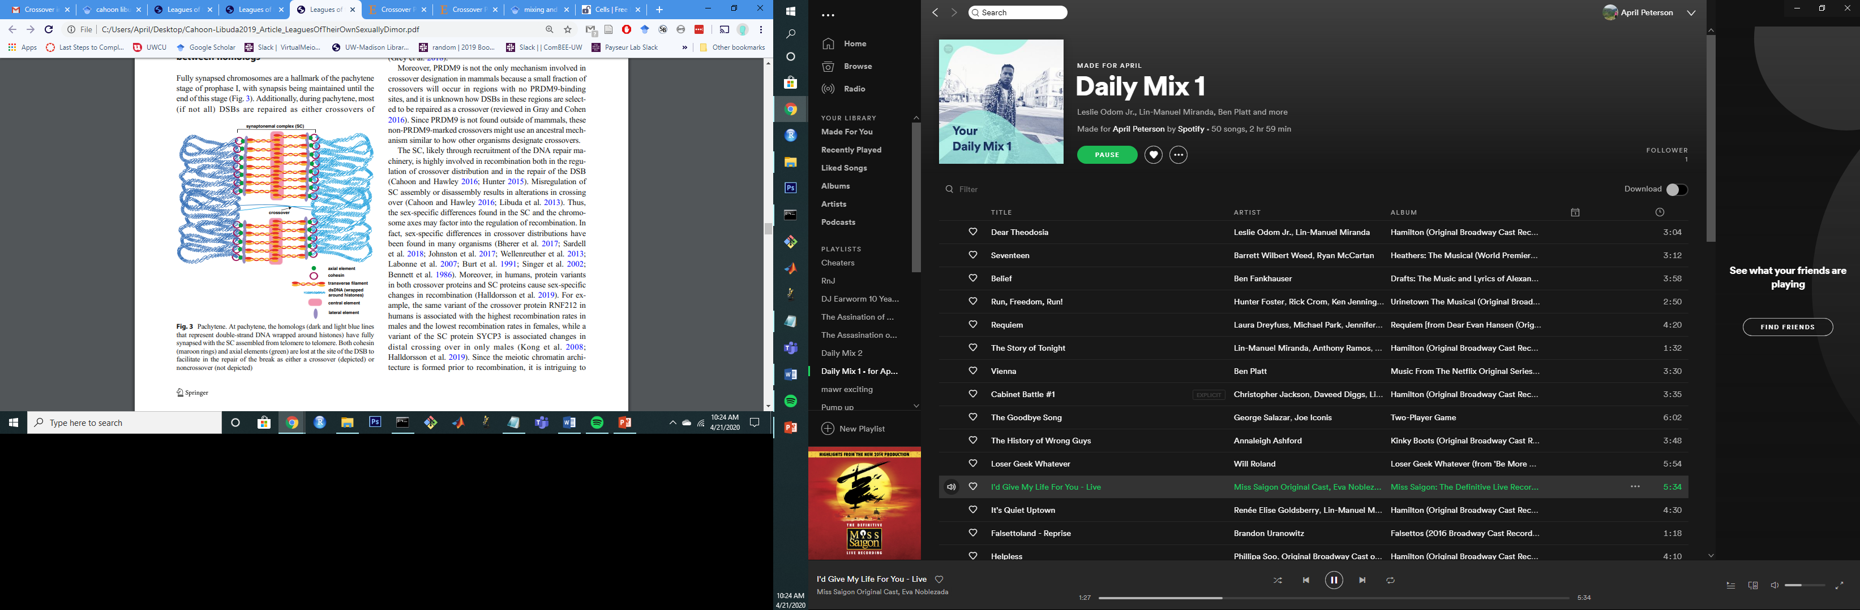
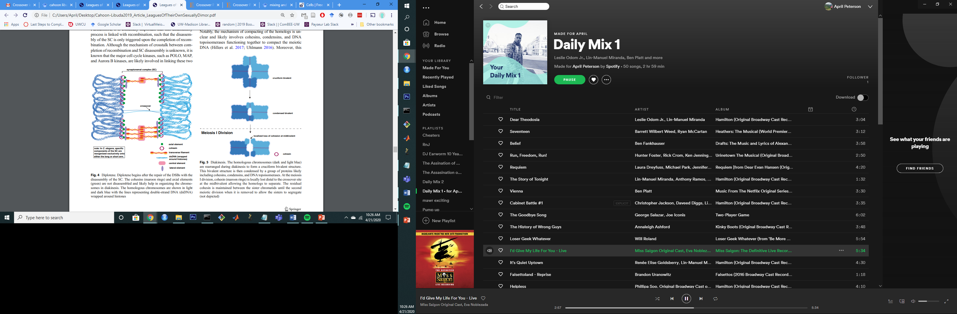
Cahoon, C. K., & Libuda, D. E. (2019). Leagues of their own: sexually dimorphic features of meiotic prophase I. Chromosoma, 1-16.

Slide 8
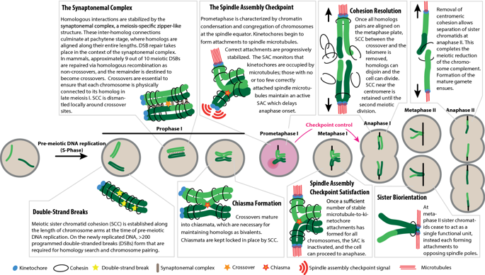
Lane, S., & Kauppi, L. (2019). Meiotic spindle assembly checkpoint and aneuploidy in males versus females. Cellular and molecular life sciences, 76(6), 1135-1150.

Slide 9
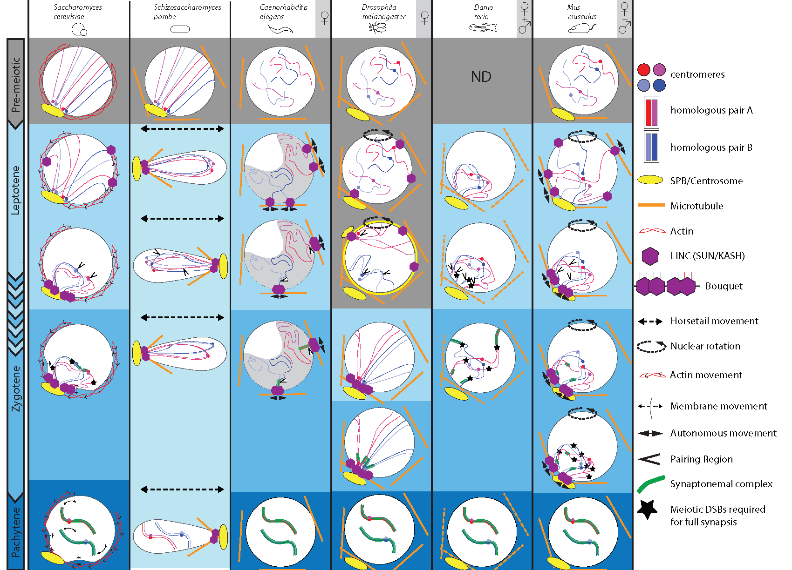
Homolog Pairing Selection
Rubin, T., Macaisne, N., & Huynh, J. R. (2020). Mixing and Matching Chromosomes during Female Meiosis. Cells, 9(3), 696.
Notes:
That one paper….

Slide 10
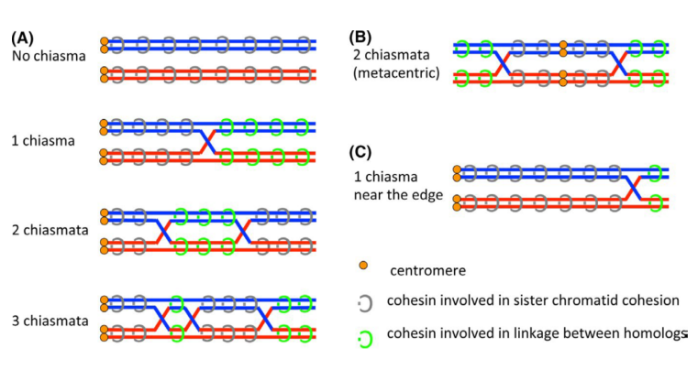
Figure aid for discussion table
Early Prophase Based Model
Metaphase – Diakinesis base model
Notes:
Figure X, example // illust
rations for
Adapted from:
Cahoon, C. K., & Libuda, D. E. (2019). Leagues of their own: sexually dimorphic features of meiotic prophase I. Chromosoma, 1-16.
Rubin, T., Macaisne, N., & Huynh, J. R. (2020). Mixing and Matching Chromosomes during Female Meiosis. Cells, 9(3), 696.
Lee, Jibak. 2019. “Is Age-Related Increase of Chromosome Segregation Errors in Mammalian Oocytes Caused by Cohesin Deterioration?” Reproductive Medicine and Biology.

Slide 11
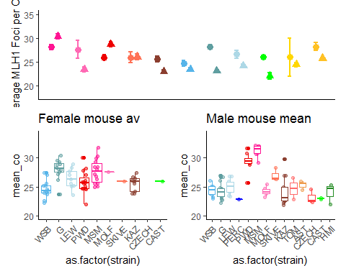
Main MLH1 figure
Notes:
Copy from code

Slide 12
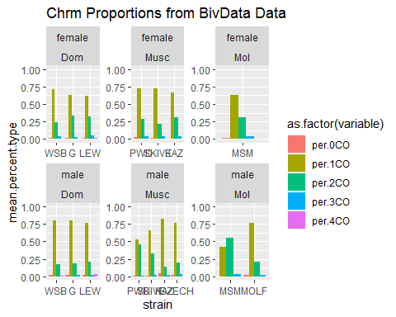
Chromosome Proportion differences

Slide 13
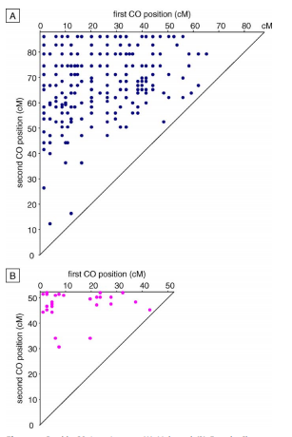
Male
First CO position
Double crossover Chrm4, Arabidopsis thaliana.
Diagonal line, 1:1 values, the shortest interfocal distance (IFD).
Near top corner, longest IFD
Enrichment of longest IFDs
Lack of small IFDs
Second CO position
Female
First CO position
Enrichment of longest IFDs
Drouaud, J., Mercier, R., Chelysheva, L., Bérard, A., Falque, M., Martin, O., ... & Mezard, C. (2007). Sex-specific crossover distributions and variations in interference level along Arabidopsis thaliana chromosome 4. PLoS genetics, 3(6).

Slide 14
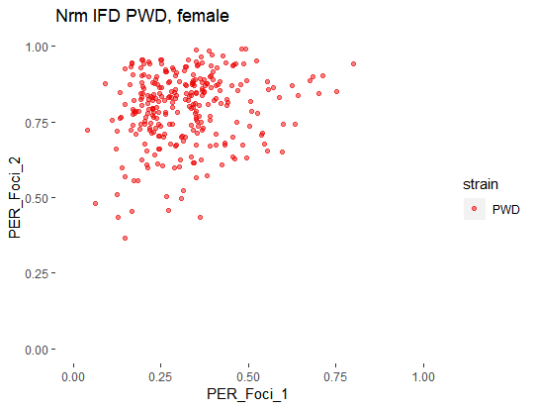
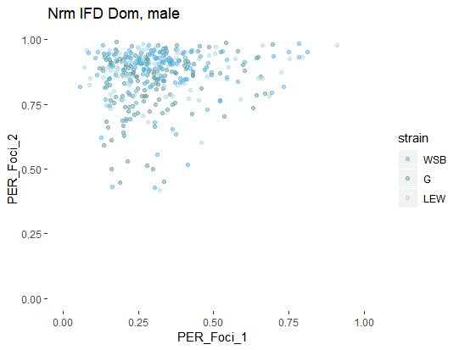
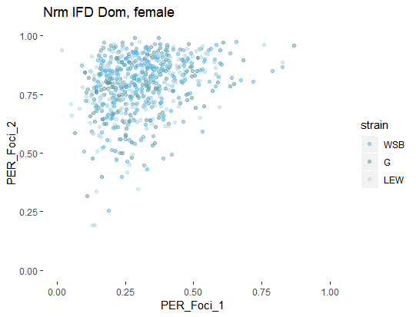
IFD figure
Longer IFD
Shorter IFDs
Notes:
Interference strength examples
(based on Dourad et al (link)
Generic example plot;
Show the difference in IFD length via closeness to diagonal line. Put example
(could try 3 axis for the 3 COs)
Centromere – supression,
Male – female difference – telomere bias (the enriched points around the top of plot
PWD – DOM, differences not quite clear (in contrast to the boxplots)

Slide 15
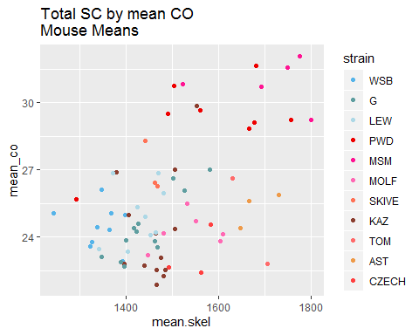
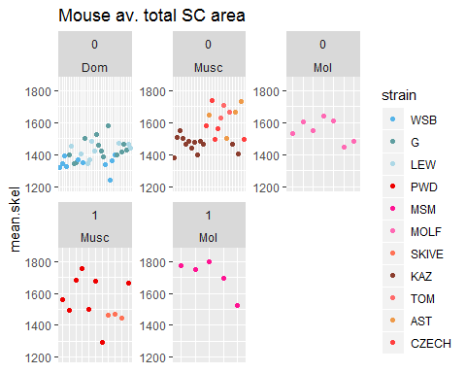
Q2 SC differences

